Slide 1
COA Lab Project (2016-17)
The LNMIIT, Jaipur
Automated Teller Machine (ATM)
Rishabh Tiwari (15UCS108)
Shubham Mangal (15UCS138)
Vishwesh Jainkuniya (15UCS161)
Vivek K. Tiwari (15UCS162)

Slide 2
Introduction
Automated teller machine (ATM), will take card(text file) as input and on successful verification, will display the transactional options. Cash transaction, Pin verification, cash withdrawal, change of pin services will be available to the user. Also, user can get mini-statement of account in form of a output text file.

Slide 3
Functions
balance()
  Displays the balance of the customer after verification.
withdrawal()
  Allow customer to withdraw the money after verification.
deposit()
  Allow admin or bank employee to deposit the money in the ATM which will be available for withdrawal by customer.
decode()
  Decodes the card entered by the customer which contains card number, pin and balance to withdraw.
showMessage()
  Manages all the messages to be shown on successful or unsuccessful verification, error, exit time & transaction.

Slide 4
Functions
VerifyPin()
  Verify the pin of the customer’s card by matching the card number and relevant pin.
changepin()
  Changes the pin number stored in the database of a customer on verifying the previous pin.
VerifyMobile()
  Sends a random number (OTP) to verify the mobile number (in this case in a text file).
cardless()
  Verify the customer on the basis of mobile number and pin instead of card.
status()
  Signals machine if ATM is working on or not.

Slide 5
Memory Model
Little-endian Aligned memory.
Byte Addressable
16-bit instruction
8-bit cell

Slide 6
Registers
General Registers - 16
r0 - r9
Pin
NPin
Batm
Program Counter
Special Purpose Registers
Flag Register (Z, N, O)

Slide 7
Instruction Format
zero - address instruction
  decode
  ret
  start
  hlt
one - address instruction
  jeq
  cal
  inc
  dec
two address instruction
  add
  mov
  sub
  cmp

Slide 8
Instruction Design
opcode -16bit
opcode -12bit address -4bit
opcode -8bit address -4bit address -4bit
opcode -4bit address -4bit value -8bit

Slide 9
Instruction Types
Data movement instructions
mov
Arithmetic and logical instructions
add
sub
inc
dec
Comparison instruction
cmp
Control Transfer instructions
jeq
ret

Slide 10
Data Types
Signed 8 bit integer

Slide 11
Addressing Modes
Immediate addressing
register mode
stack addressing
indirect addressing

Slide 12
Flow of Control Handling
decode()
  verifyPin()
  balance()
  withdrawal()
  changePin()
cardless()
  mobileVerify()
  balance()
  withdrawal()
deposit()
Instructions are successively fetched and decoded from consecutive memory locations.
Procedure call will cause the flow of control to be altered, stopping the procedure currently executing and starting the called procedure.

Slide 13
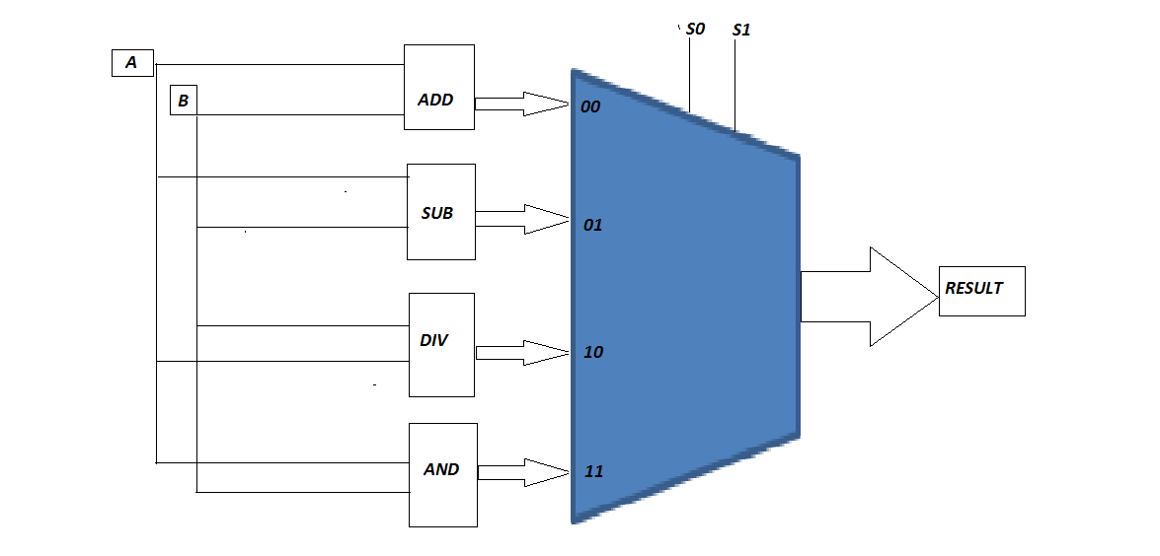
ALU Design

Slide 14
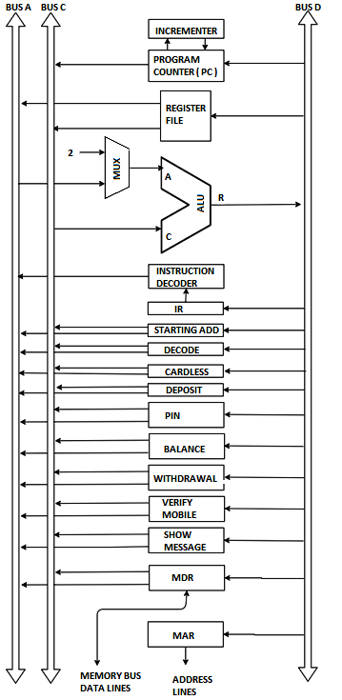
Data Path

Slide 15
CONTROL UNIT
Instructions will be fetched from memory cache (or from memory, if cache is missed)
Fetch cycle
  PC_{out} , R=C , MAR_{in} , Read , IncPC
  WMFC
  MDR_{out} ,C_{in}, R=C , IR_{in}
Instruction pass through decoding unit.
After decoding the instruction, Microroutines are executed.

Slide 16
MicroRoutines
Two Address Instructions
Add R1 R2
  R1_{outA} , R2_{outC} , Select A, ADD, Temp_{in}
  Temp_{outC} , R=C , R1_{in} , END
Sub R1 R2
  R1_{outA} , R2_{outC} , Select A, SUB, Temp_{in}
  Temp_{outC} , R=C , R1_{in} , END
Mov R1 R2
  R2_{outC} , R=C , R1_{in}, END
Cmp R1 R2
  R1_{outA} , R2_{outC} , Select A, SUB, R3_{in} , END

Slide 17
Deposit Batm R3
  Batm_{outA} , R3_{outC} , Select A, ADD, Temp_{in}
  Temp_{outC} , R=C , Batm_{in} , END
VerifyPin ImdValue R3
  SA_{outC} , R=C , R3_{in}
  R3_{outC} , R=C , IN , MAR_{in} , Read
  WMFC , R3_{outC} , R=C , Select A, SUB, R4_{in}
  if Z=0 , branch to micro-instruction 6
  INC μPC ( 8 ), branch to micro-instrcution 2
  INC μPC ( 2 ), R5,_{in}
  R5_{outC} , R=C , IN , MAR_{in} , Read
  WMFC ,MDR_{outC} , R=C , R6_{in}
  R6_{outA} , ImdValue_{outC} , Select A, SUB, Temp_{in}
  if Z=0, verified = 1, END

Slide 18
Balance
  Balance_{outA} , showMessage = 1, END
Withdrawal R0
  R0_{outA} , Balance_{outC} , Select A, SUB, R7_{in}
  If N = 1, END
  R7_{outC} , R=C , Balance_{in}
  END
ChangePin R1
  R1_{outC} , R=C , P_{in} , MDR_{in}
  R5_{outA} , R=C , OUT , MAR_{out} , WRITE , END
Status R9
  R9_{outC} , R=C , S_{in} , Status = 1, END

Slide 19
VerifyMobile R3
  SA_{outC} , R=C , R3_{in}
  R3_{outC} , R=C , IN , MAR_{in} , Read
  WMFC , R3_{outC} , R=C , Select 2 , SUB, R4_{in}
  if Z=0 , branch to micro-instruction 6
  INC μPC ( 8 ), branch to micro-instrcution 2
  send OTP = 1, Wait For Input, R6_{in}
  R6_{outA} , OTP_{outC} , Select A, SUB, Temp_{in}
  if Z=0, verified = 1, END

Slide 20
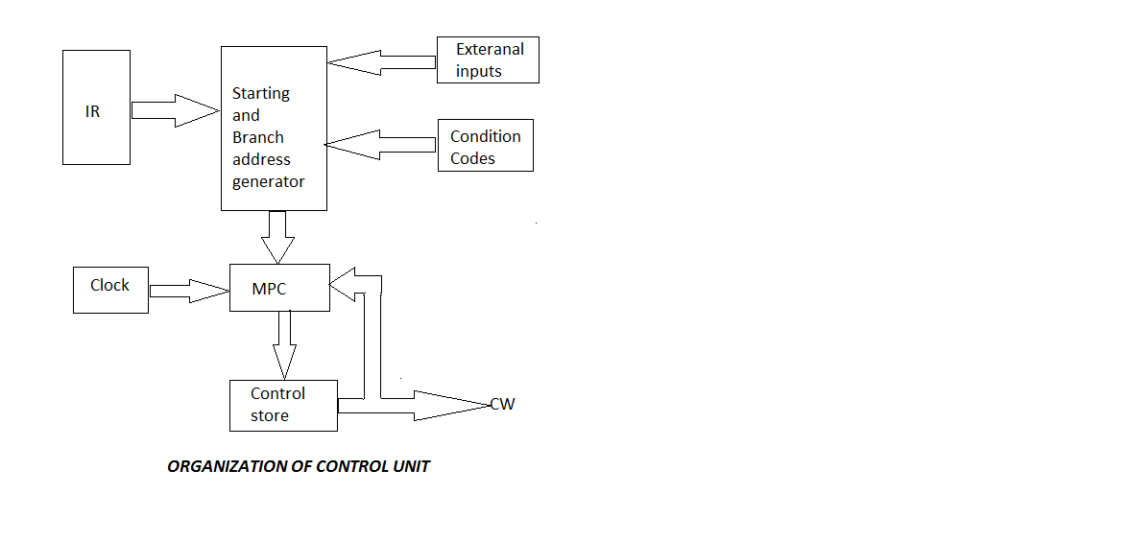
CONTROL UNIT

Slide 21
CONTROL WORD TABLE
Change PIN
MicroInstruction | R1_{out} | P_{in} | MDR_{in} | R5_{out} | MAR_{out} | Write | END
1 | 1 | 1 | 1 | 0 | 0 | 0 | 0
2 | 0 | 0 | 0 | 1 | 1 | 1 | 1

Slide 22
THE END

